Slide 1

Computing Evolution

Slide 2

What is Computing ?

Slide 3
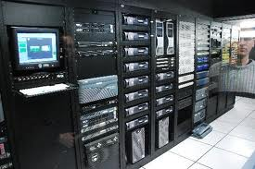
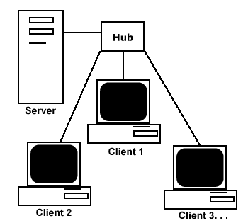
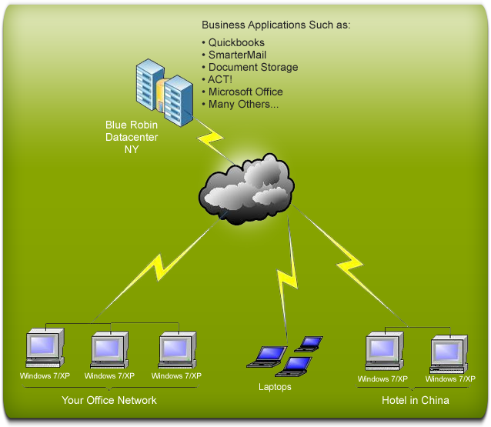
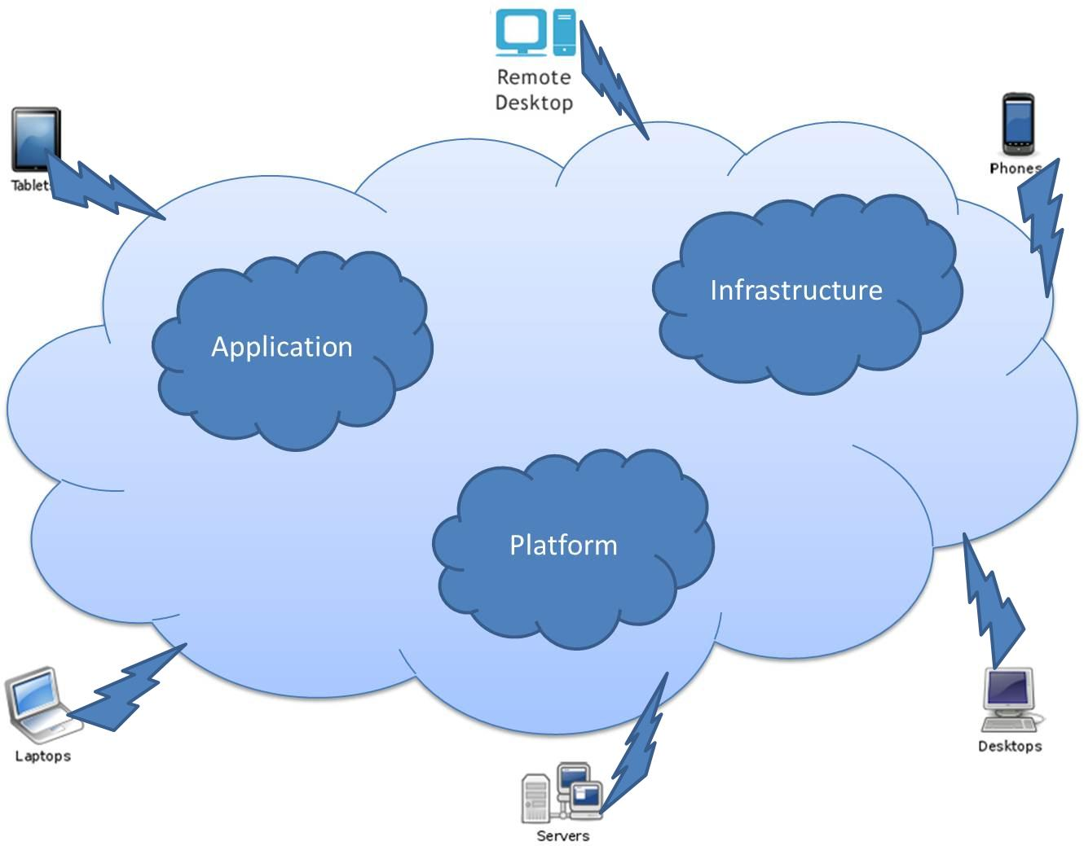
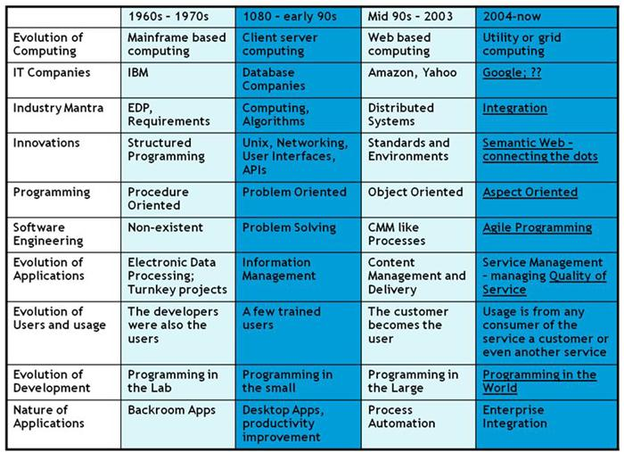

Slide 4
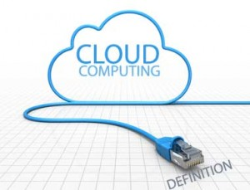
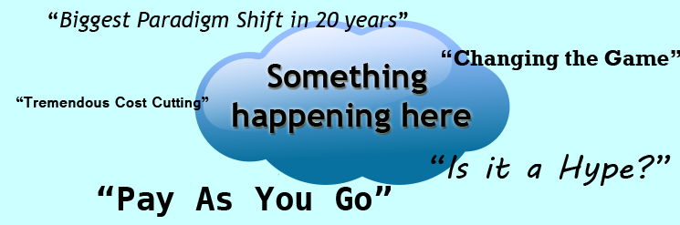
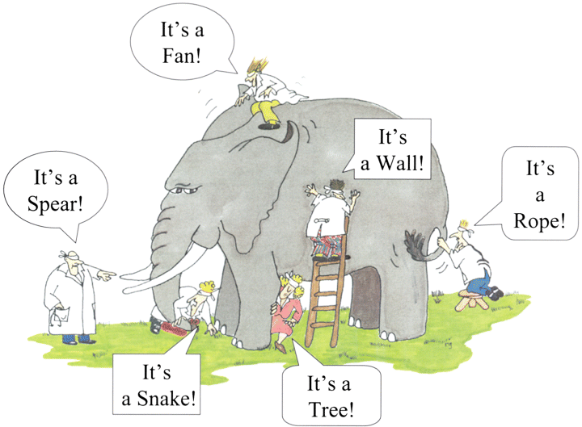
Cloud Computing
Different Users - Different Perspectives

Slide 5
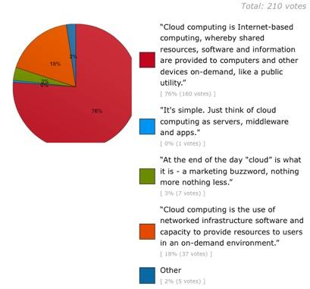
Cloud Definition - Twitter Poll Results

Slide 6

Introduction : Business and IT perspective, Cloud and virtualization, Cloud services requirements, cloud and dynamic infrastructure, cloud computing characteristics, cloud adoption.

Slide 7
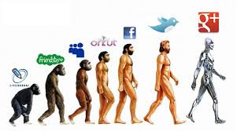

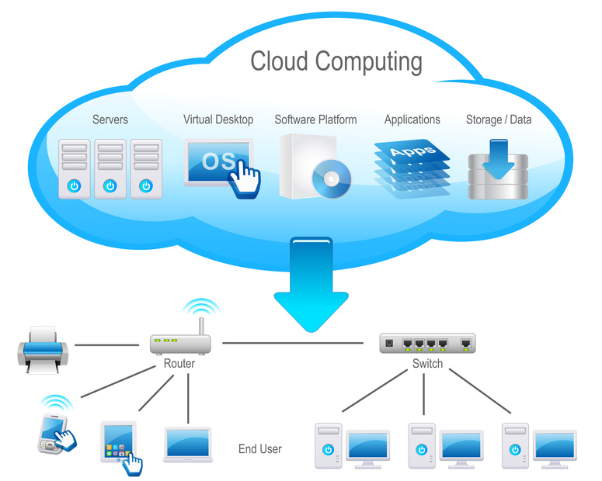

1.1 Business and IT Perspective
The impressive success of companies such as
Google, Facebook with the use of Cloud Computing has made companies to think towards making similar services and user experience to their users - employees, partners and customers.

Slide 8
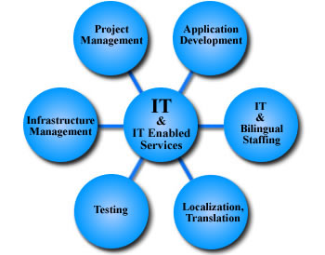

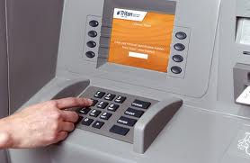
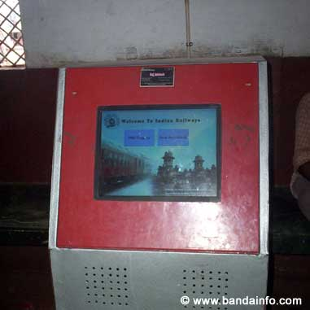
1.1 Business and IT Perspective
Delivering IT -enabled services
via internet, that are built for the
end-users to be in control is
what has come to be called as "Cloud Computing". Ex: Gmail.
Self-Service is an important characteristic of Cloud Computing.
Ex -1: Bank ATM -
2- PNR Status Check in Railway Stations.

Slide 9
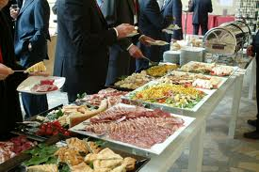
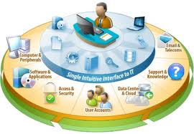
Self Service - Illustration

Slide 10
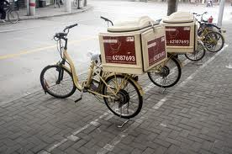
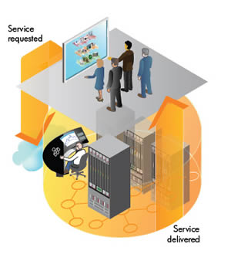
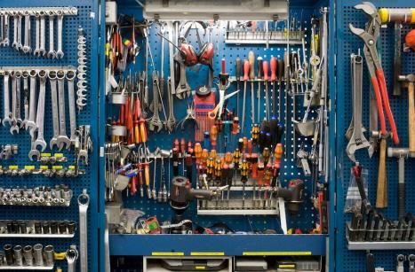

1.1 Business and IT Perspective
Cloud Computing is an emerging consumption and delivery model
that enables provisioning of standardised business and computing services through a shared infrastructure, where-in end user is enabled to control the interaction in-order to accomplish the business task.

Slide 11
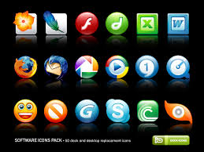
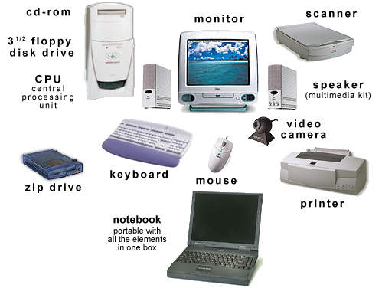
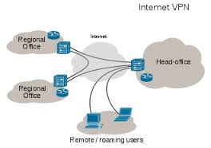
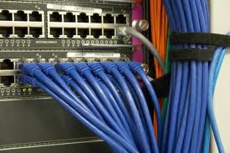
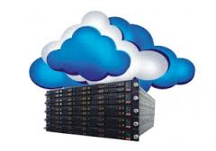
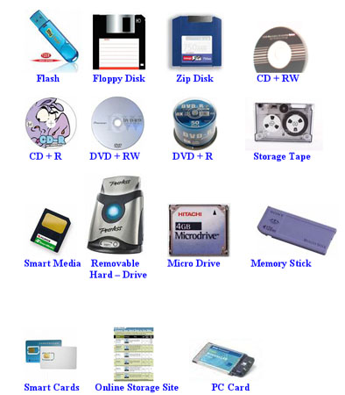
1.1 Business and IT Perspective
Computing resources such as hardware , software
networks - ,storage,
services
and interfaces are no longer confined within the four walls of the enterprise.

Slide 12
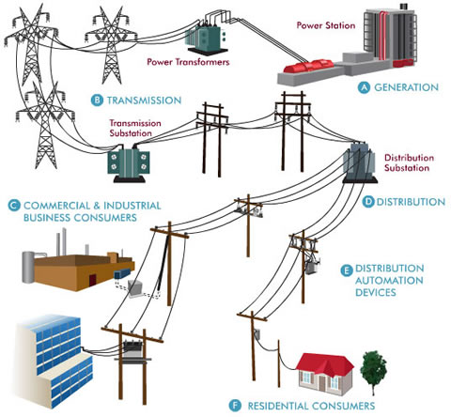
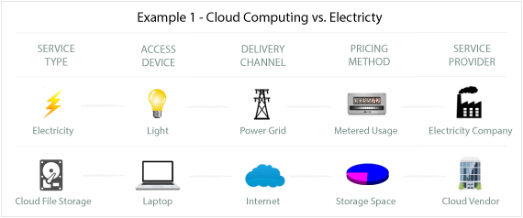
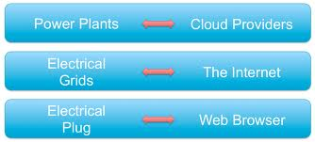
1.1 Business and IT Perspective
Essentially everything needed from a computing
resources perspective is provisioned by the cloud ,
much like electrical power grid -

Slide 13
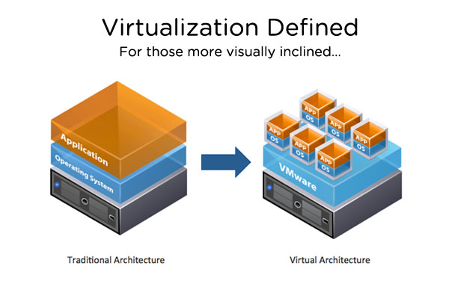
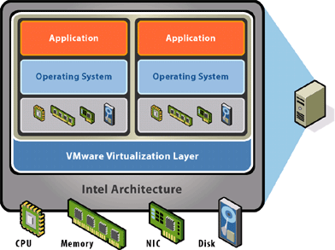
1.2 Cloud and Virtualization
Virtualization has a longer history of more than 30 years.
Virtualization is the
foundation for all that is
possible through cloud -

Slide 14
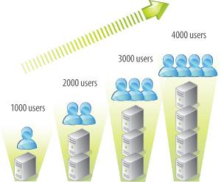
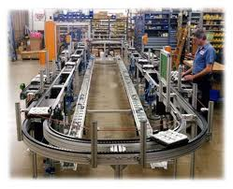
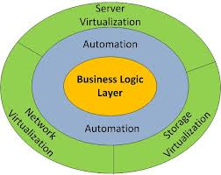

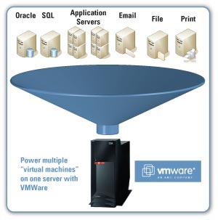
1.2 Cloud and Virtualization
Scalability -
, Automation -
, Standardised services -
, are possible only because of
underlying Virtualization.

Slide 15

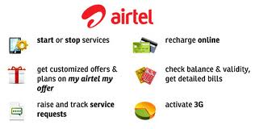
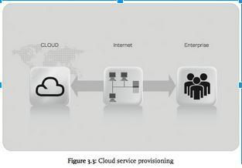
1.2 Cloud and Virtualization
Cloud Computing promises :
self-service -
self-provisioning -
rapid provisioning
(web-based - takes minutes) -
To be able to realise these in practise virtualization must be implemented.

Slide 16
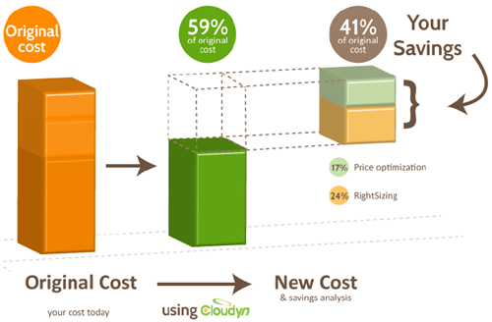

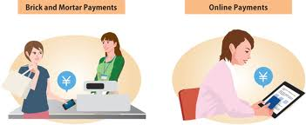
1.2 Cloud and Virtualization
Virtualization gives rise to cost savings -
and improve services -

Slide 17
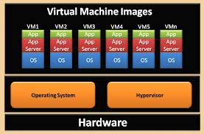
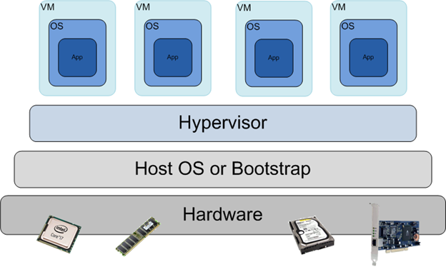
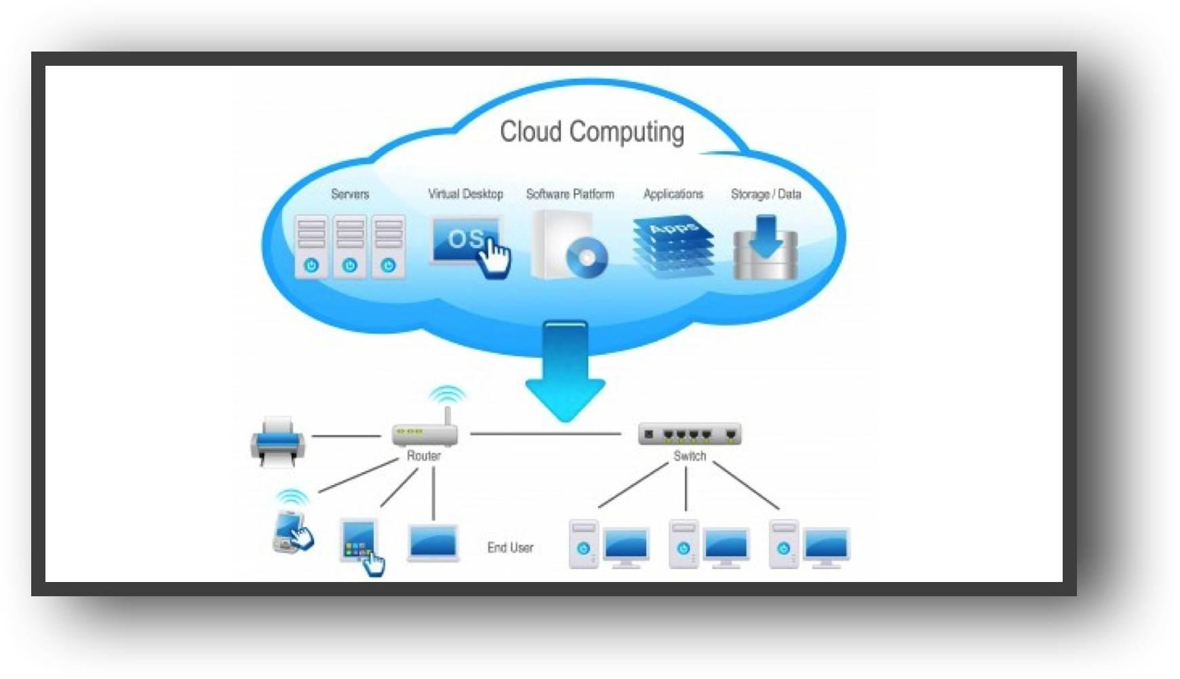
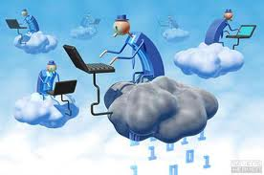
1.2 Cloud and Virtualization
1.2 Cloud and Virtualization
1.2 Cloud and Virtualization
1.2 Cloud and Virtualization

Slide 18
1.2 Cloud and Virtualization
Results of Virtualization: (text book pg 8-9)
Server/Storage - pooled
Automation using self -service portal
Standardization thorough catalogue

Slide 19
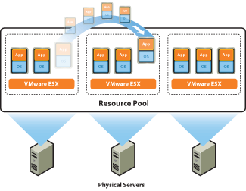
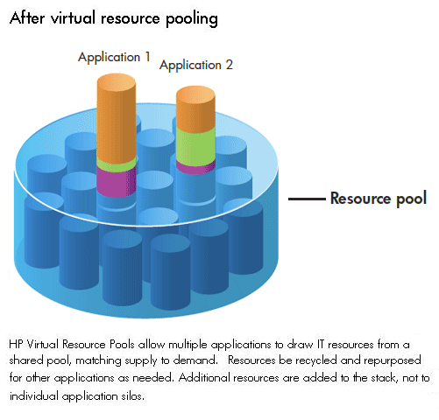
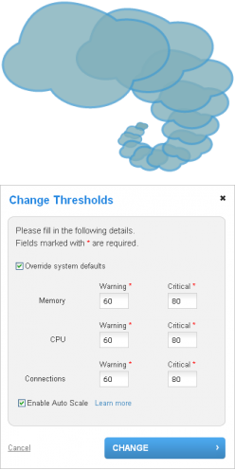
1.2 Cloud and Virtualization
Results of Virtualization: (text book pg 8-9)
Server/Storage - IT resources such as storage, network, application are pooled
to enable elastic scaling -

Slide 20
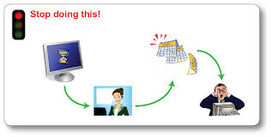
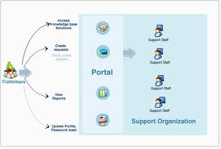
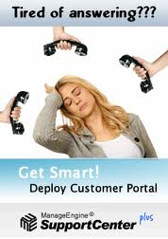
1.2 Cloud and Virtualization
Results of Virtualization: (text book pg 8-9)
Automation using self -service portal

Slide 21
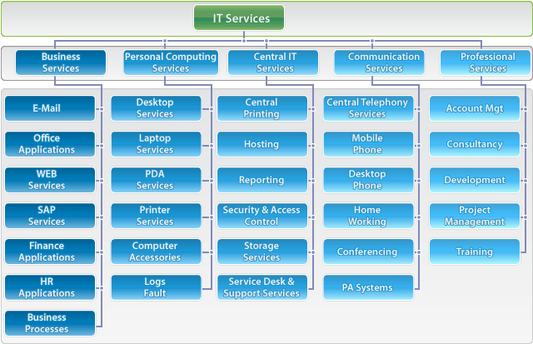
1.2 Cloud and Virtualization
Results of Virtualization: (text book pg 8-9)
Standardization thorough catalogue -

Slide 22
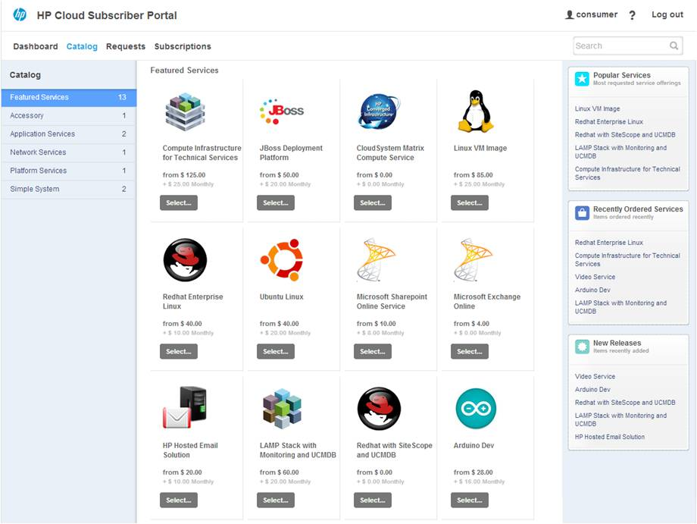
Catalogue

Slide 23

1.3 Cloud Service Requirements
A proven service management system to provide visibility, control and automation across IT.
Services to help accelerate standardization, rapid client payback on investment.

Slide 24



1.4 Cloud and Dynamic Infrastructure
Cloud Computing is Dynamic in Nature
It allows clients to access standardised IT resources to deploy new applications, services or computing resources -
rapidly without reengineering their entire infrastructure, thus making it dynamic.

Slide 25







1.3 Cloud Service Requirements
Cloud Dynamic Infrastructure provides the following features:
Service Management
Asset Management
Virtualization and Consolidation
Information Infrastructure
Energy Efficiency
Security
Resilience

Slide 26


Cloud Computing Characteristics - Primary
Cloud computing uses commodity based hardware as its base - replace h/w without affecting the cloud.
It uses commodity based software container system - Ex: service should
be able to be moved from one
cloud provider to any other cloud
provider with no effect on the
service.

Slide 27






1.5 Cloud Computing Characteristics - Secondary
Virtualization
Abstraction layer for h/w, s/w and configuration systems
Multi-tenant system
Pay as you go with no-lock in
Privacy and Security of Data
Flexible migration and restart capabilities
Autonomic Computing - Automated restarts, automated resource expansion and contraction
Dynamic Scaling - Horizontal / Vertical

Slide 28

Cloud Computing - Essential Characteristics

Slide 29

Cloud Computing - Essential Characteristics

Slide 30




1.6 Cloud Adoption
Business function that suits cloud adoption can be low-priority business applications :
Business intelligence against large database
Partner facing project sites
Low priority services

Slide 31



1.6 Cloud Adoption - cntd
Cloud favours traditional web applications and interactive applications that comprise two or more data sources and services
services with low availability requirements and short life spans
Enterprise marketing campaigns need quick delivery of services and can just be quickly be switched off.

Slide 32





1.6 Cloud Adoption - Cntd
Helpful for high volume, low cost analytics and disaster recovery scenarios, business continuity, backup/recovery-based implementation.
ghdgh
jjh
One time batch processing with limited security requirements
Record retention

Slide 33




1.6 Cloud Adoption - Cntd
Media distribution
Mature packaged offerings - email
Collaboration infrastructure and collaborative business networks

Slide 34





1.6 Cloud Adoption - cntd (based on technical characteristics)
Applications that are modular and loosely coupled
Isolated workloads
Single Virtual Appliance Workload
Software Development and Testing
Pre-Production Systems
R & D Projects
Prototyping to test new services and applications
Design models and applications that scale horizontally on small servers

Slide 35



1.6 Cloud Adoption - cntd
Applications that need significantly different levels of infrastructure throughout the day
Applications that are used solely during business day
Applications with seasonal demand
Applications that need different levels of infrastructure throughout the month

Slide 36



1.6 Cloud Adoption - cntd
Applications where demand is unknown in advance - web start -up will need to support a spike in demand when it becomes popular, followed by reduction once some of visitors turn away.

Slide 37




Cloud Adoption - Not Suitable
Mission critical and core business applications, transaction processing and application that depend on sensitive data normally restricted to organization requiring high level of accountability and auditability
Applications that run 24/7/365 with steady demand

Slide 38



Cloud Adoption - Not Suitable
Applications that consume significant amount of memory, that demand large memory cache, database, data-sets
Applications that take full advantages of multiple cores - parallel processing - that benefit from many cores on a single server are not good for cloud deployment.

Slide 39



Cloud Adoption - Not Suitable - cntd
Applications that require high -performance file system I/O , needing bandwidth, inter-server communications - highly distributed applications,
Cloud does not work well with applications that scale vertically on single server, and applications dependent on third party software, which does not have virtualization or cloud aware licensing strategy.

Slide 40

Summary

Slide 41

Summary

Slide 42



Slide 43


